Slide 1





Slide 2

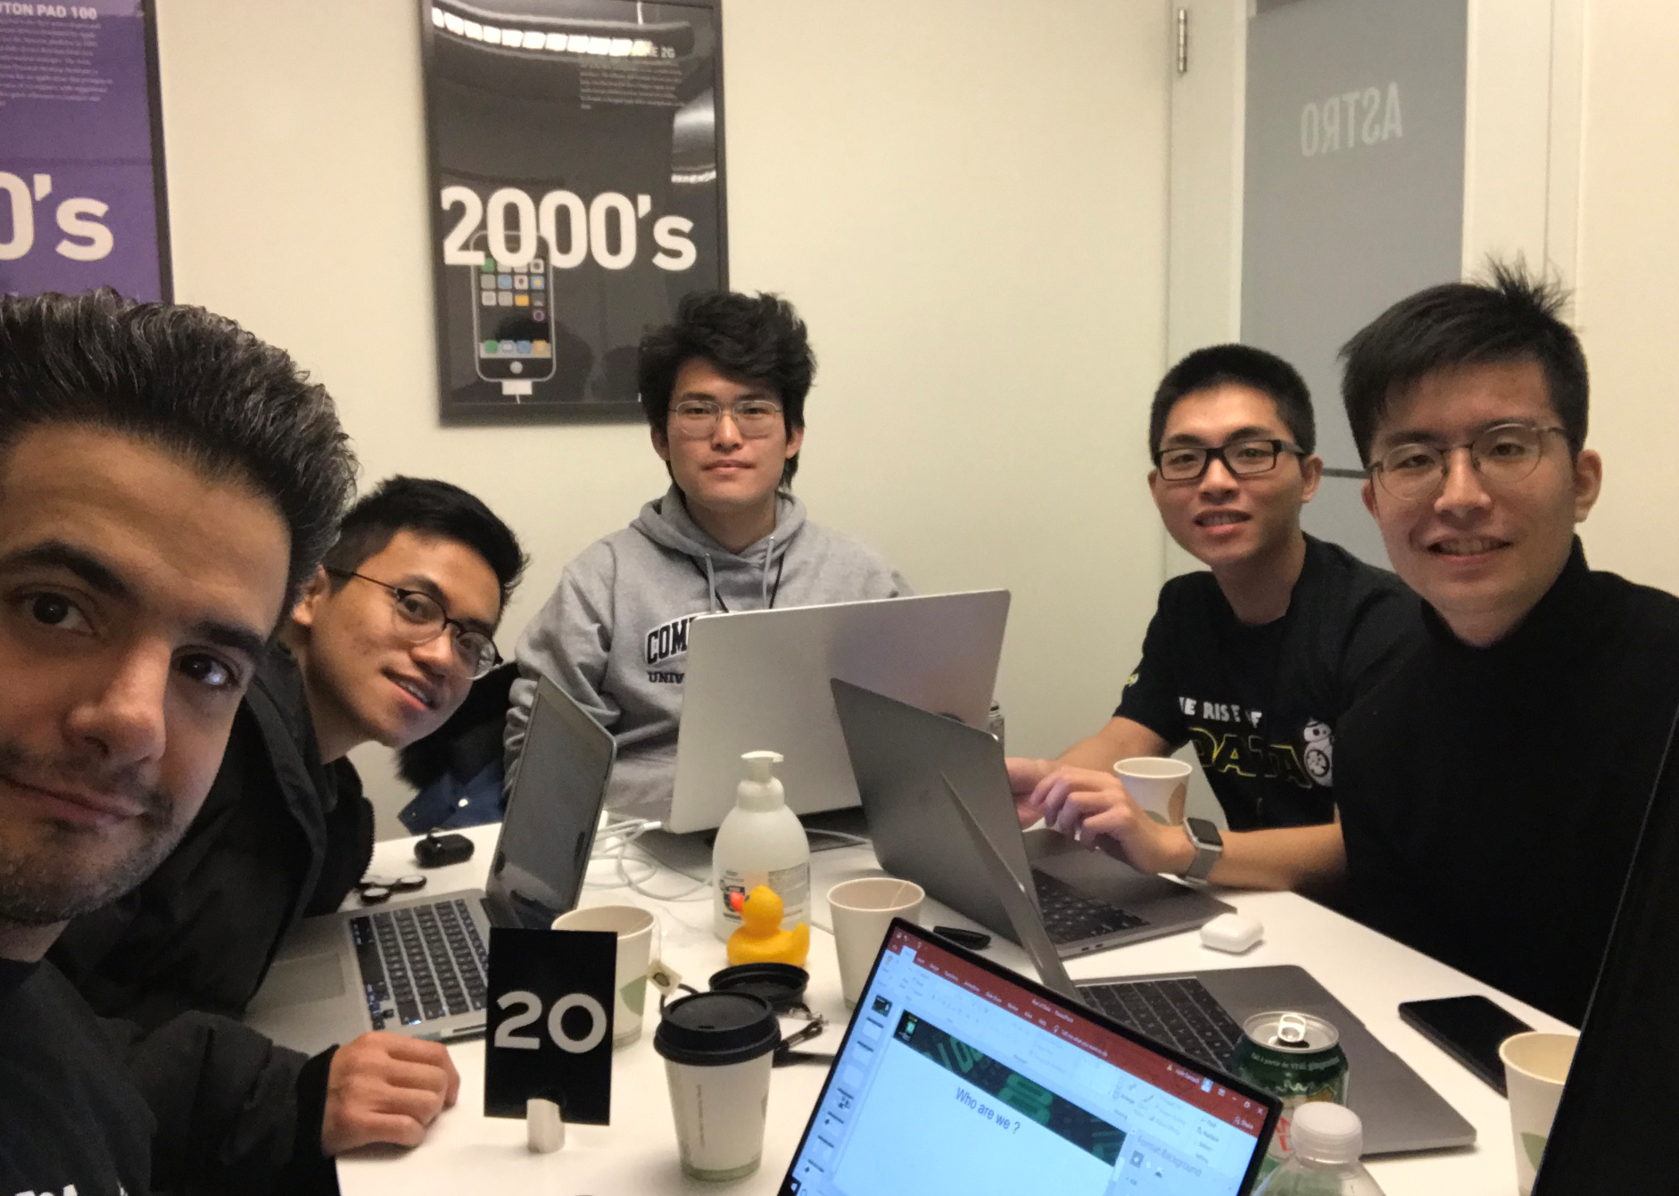
Who are we ?
James
Josh
Vincent
Derek
Polo

Slide 3

Social Media, Twitter and Earning Calls Have Impact on Stocks !
What is the challenge?
To What Extend Earning Calls & Stocks Are Associated !

Slide 4
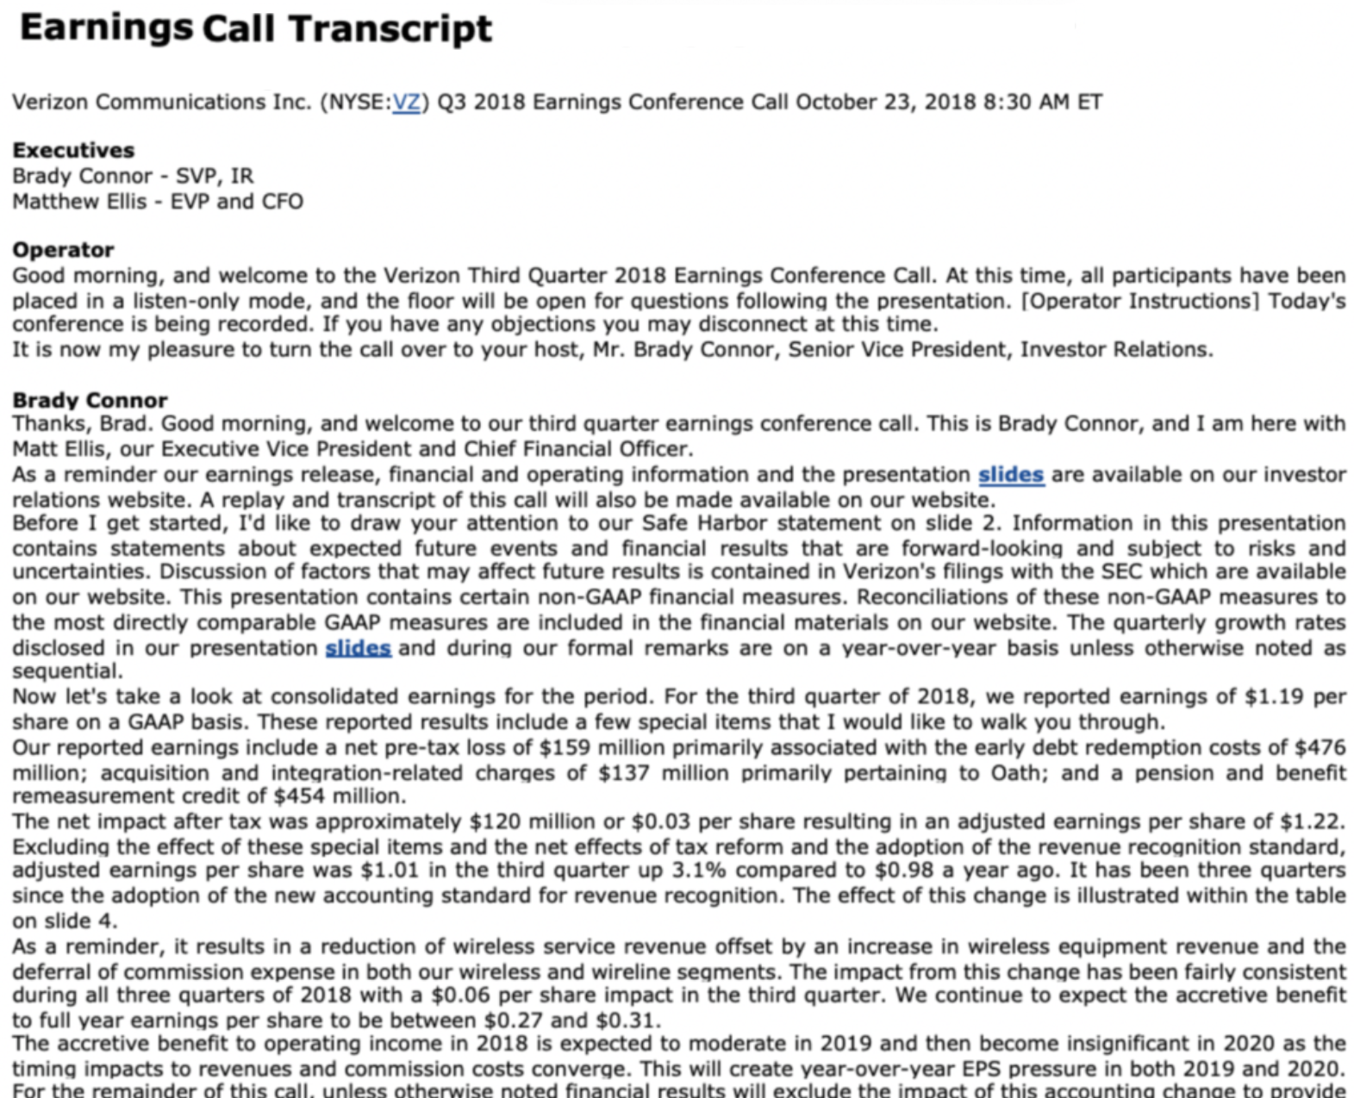


Why are we here ?
55% Accuracy
0.0016 MSE
We Are Close to Solve the Problem !

Slide 5

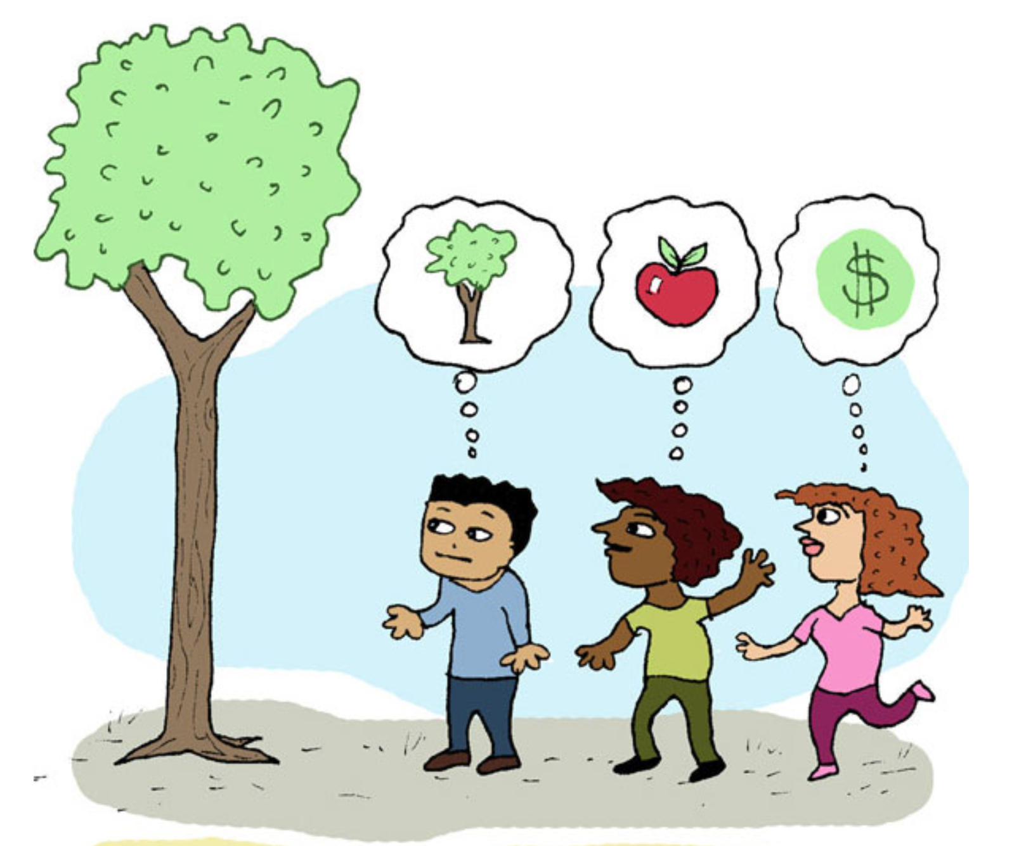
What are the complications ?
Management are very careful with the language they use !
People’s understanding of words and sentiments are subjective !

Slide 6
What did we do ? Step #1
Earnings Call Transcripts
Q&A
Mgt Discussion
Our Model Differentiates Between the Two
By finding the Q&A Section
Sentiments Are Different !

Slide 7

Step #2
Loughran McDonald Master Dictionary
Finance Related Terms
Sentimental Analysis for Scoring MD & Q&A

Slide 8
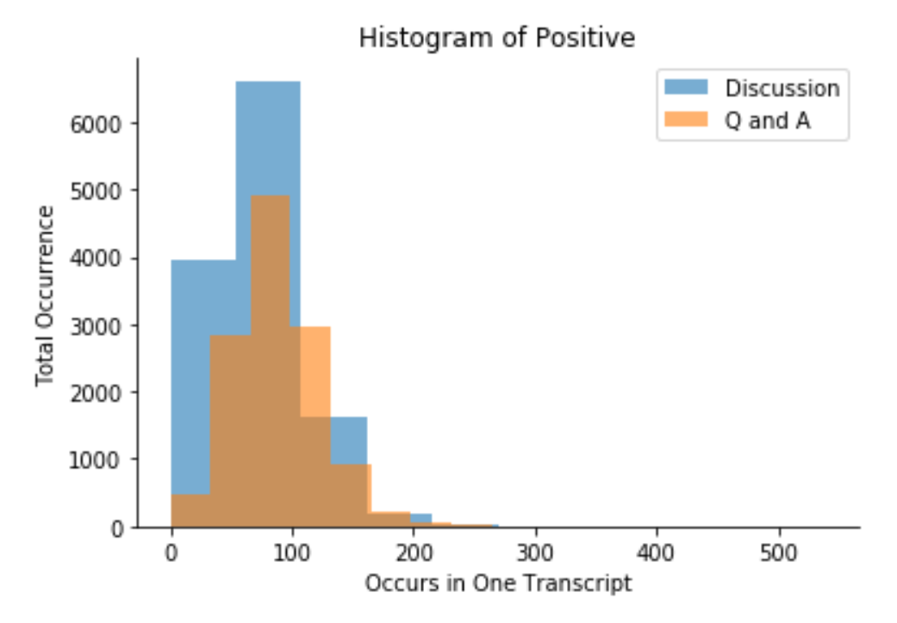
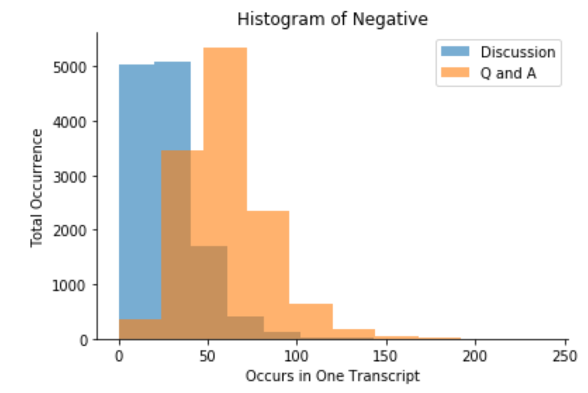
Positive Vs Negative Sentiment

Slide 9
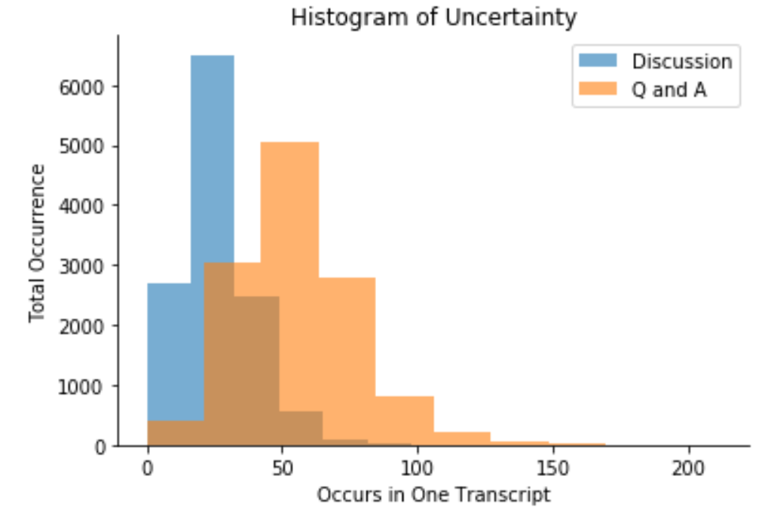
Uncertainty

Slide 10
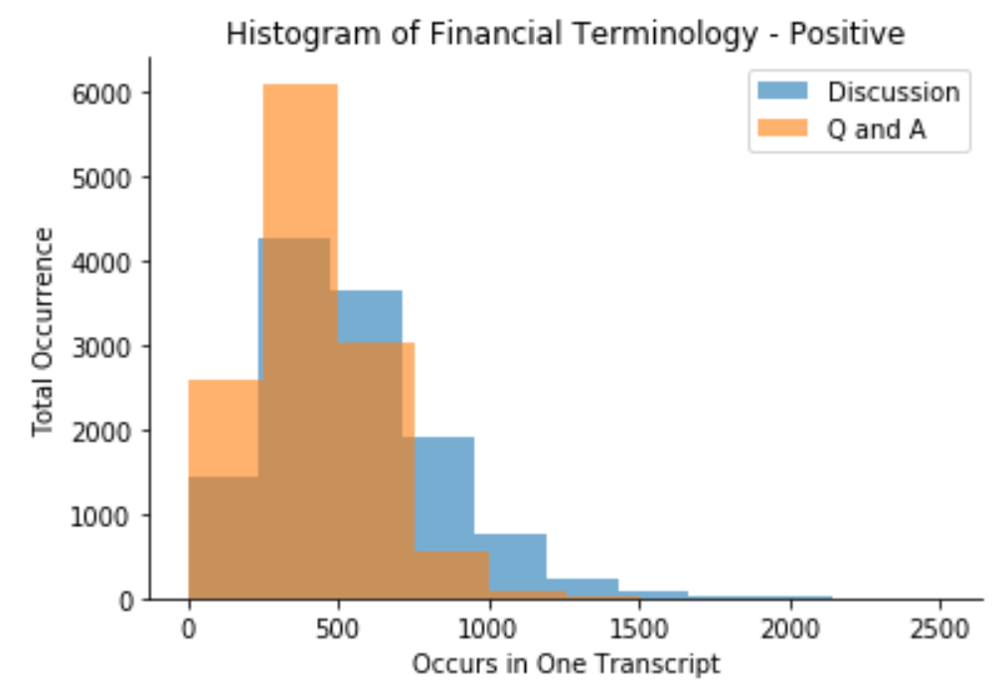
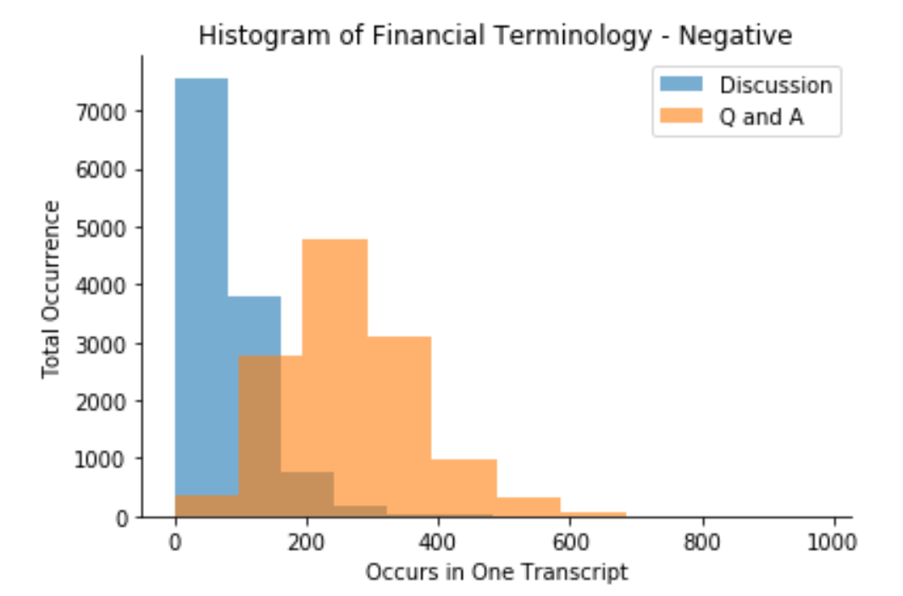
Financial Terms

Slide 11


Random Forest
MD
Q&A
Step #3 – Model Selection (Cross Validation)
XG Boost
MD
Q&A
Support Vector Regression
MD
Q&A

Slide 12
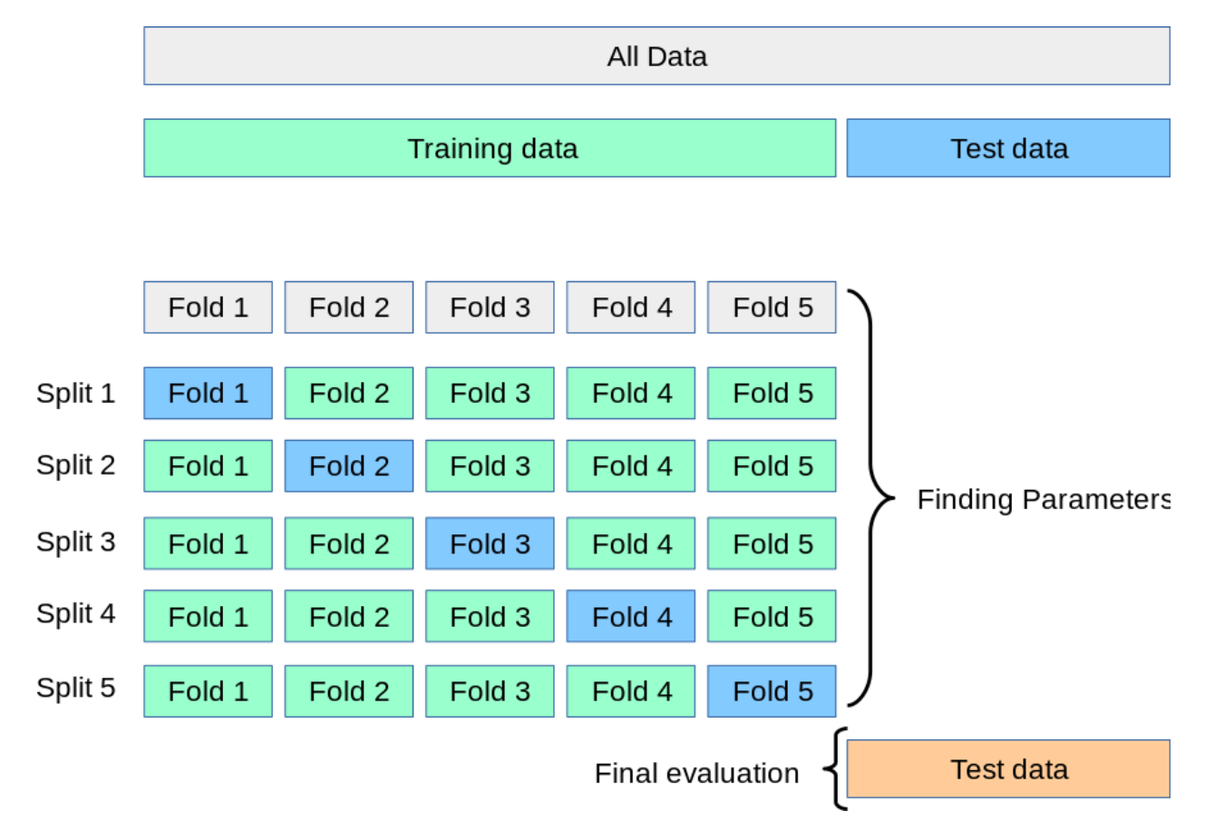

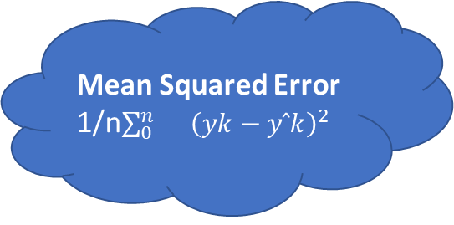
Step #4 – Evaluation Using MSE
Mean Squared Error
1/n$\sum_{0}^{n}{}{\left(yk−yˆk\right)}^{2}$

Slide 13
Future Improvements
Negation words analysis, specially in Q&A section.
Sentiment Throughout Earning Calls, to find Noticeable dips.
Sentence complexity analysis.

